Slide 1





I was a Sys Admin. Am I a Developer Now?
Scan this QR-code to access free resources, step-by-step learning guides as well as get practical experience in Azure!
https://aka.ms/AAbgmyy
Don’t forget to add Microsoft Azure as a skill to your LinkedIn account to stay connected with a developer community!
+ Microsoft Azure
We post the latest announcements about free events for developers in Ireland on our official Twitter account!
@MSDevIRL

Slide 2
I was a (happy) sysadmin. Am I developer now?
Vladimir Stefanovic, Microsoft Azure MVP, Cloud Solution Architect @SuperAdmins
Milos Katinski, Azure Community Hero, Azure Cloud Engineer @ABN Amro

Slide 3

Who we are?
vladimir@Azure:~$ az speaker show –output json
{
"speakerName": "Vladimir Stefanovic",
"location": "Belgrade, Serbia",
"titles": "Microsoft MVP, MCT RL",
"position": „CSA @SuperAdmins",
„community": „Azure Serbia UG, AzureSaturday.rs",
"twitter": "@wladinho31"
}

Slide 4

Who we are?
milos@Azure:~$ az speaker show –output json
{
"speakerName": "Milos Katinski",
"location": "Amsterdam, Netherlands",
"titles": "Azure Community Hero",
"position": "Cloud Engineer @ABN Amro",
„community": "Azure Serbia UG, AzureSaturday.rs",
"twitter": "@miloskatinski"
}

Slide 5
This is based on an example of usual Windows Sysadmin
Real-world story

Slide 6
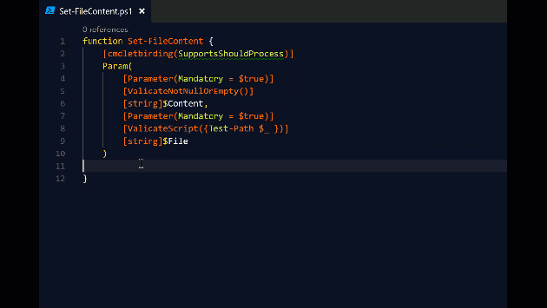



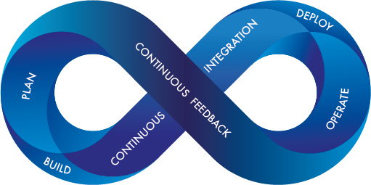
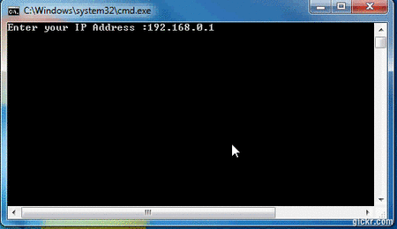
What was happen with the (happy) sysadmin?
A long time ago, a sysadmin's favorite tool was a mouse...
Later, a sysadmin started to use a keyboard for simple commands or scripts...
Of course, there were sysadmins highly skilled in commands line utilities and scripting
And then, someone decided to introduce PowerShell, Azure, DevOps, and many other cool technologies and tools

Slide 7

What was happen with the (happy) sysadmin?
At the end of the story, does the sysadmin became a developer?

Slide 8
What does the cloud admin need to know today?
Old school admin will not change the mindset and continue to use a mouse (Azure Portal)
A modern admin will learn different techniques and pay attention to automation
PowerShell
Azure CLI
ARM Templates
Terraform
Ansible
Azure DevOps
GitHub Actions
…

Slide 9

We will do the same deployment using different tools
PowerShell vs. AzureCLI vs. ARM vs. Terraform

Slide 10


Slide 11
I was a Sys Admin. Am I a Developer Now?
Scan this QR-code to access free resources, step-by-step learning guides as well as get practical experience in Azure!
https://aka.ms/AAbgmyy
Don’t forget to add Microsoft Azure as a skill to your LinkedIn account to stay connected with a developer community!
+ Microsoft Azure
We post the latest announcements about free events for developers in Ireland on our official Twitter account!
@MSDevIRL

